Slide 1
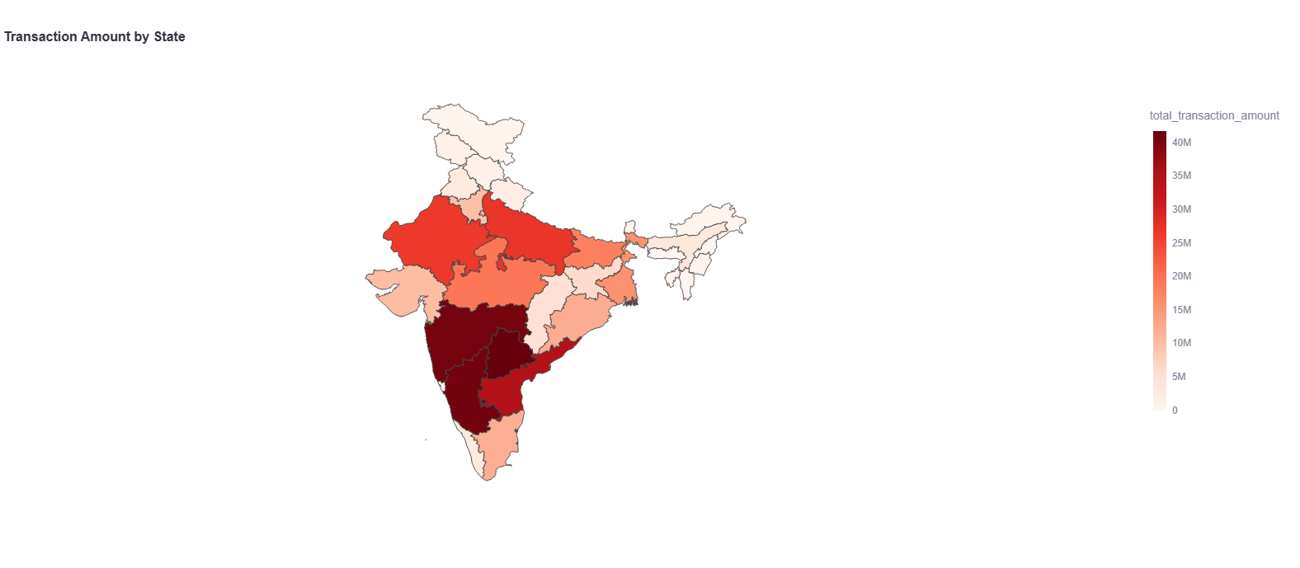
PhonePe Pulse Data Analysis & Dashboard
Decoding Digital Transactions Across India
by,
Sindhu K

Slide 2
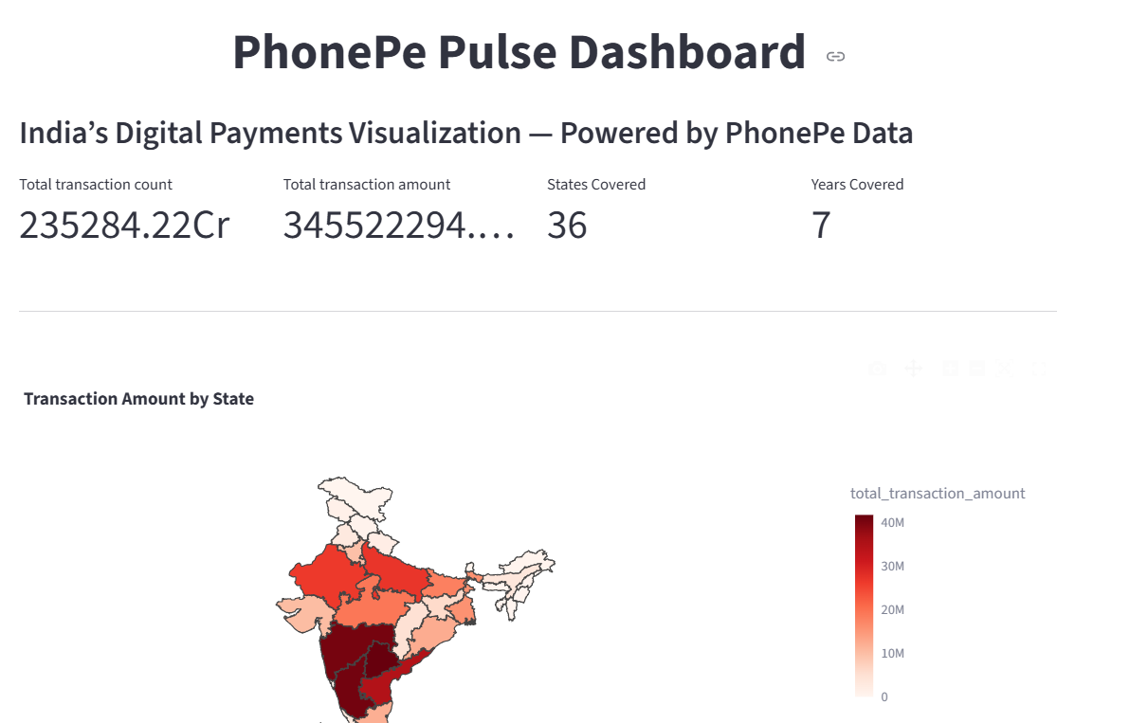
Introduction to PhonePe Pulse
What is PhonePe Pulse?
A public data platform launched by PhonePe
Provides detailed insights on digital transactions across India
Covers transactions, users, insurance, etc. over time
Why Analyze It?
Understand regional transaction patterns
Identify high-growth states and districts
Support market expansion and targeted campaigns

Slide 3
Project Objectives
Objectives:
Analyze transaction trends by state, year, and quarter.
Identify top and bottom performing states based on transactions.
Explore category-wise payment distribution to understand user behavior.
Provide actionable business recommendations based on insights.

Slide 4
Tools & Technologies
Languages: Python, SQL (PostgreSQL)
Libraries: Pandas, Plotly, Streamlit, Seaborn
Visualization Tool: Streamlit dashboard

Slide 5
Decoding Transaction Dynamics
Insights:
Maharashtra, Karnataka, Tamil Nadu lead in both transaction value and volume.
Northeastern states have lower transaction numbers but are showing steady growth on year on year
Peer to Peer Payments make up the majority of transaction categories.
Quarter 4 shows peak transactions, likely driven by festivals.

Slide 6
Decoding Transaction Dynamics
Recommendations
Offer special deals in states with fewer transactions to attract more
users.
Run big campaigns during festivals to boost transactions in Q4.
Promote less popular services like financial to increase usage.
Encourage people in smaller cities to use peer-to-peer payments more.

Slide 7
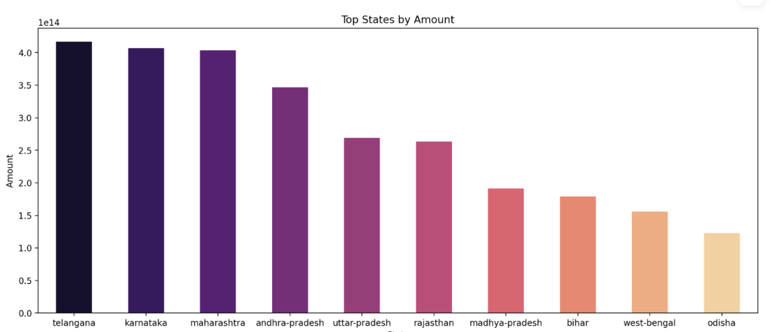
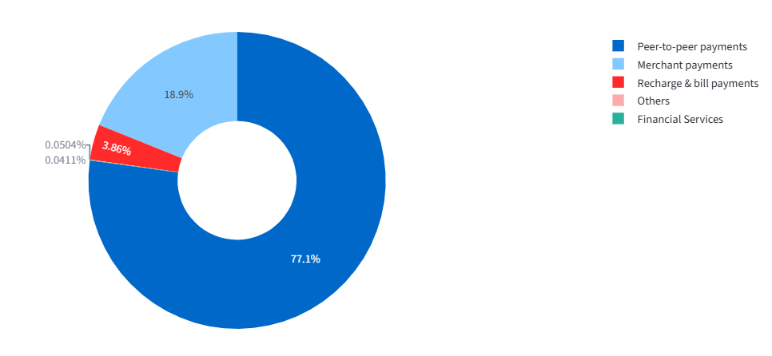
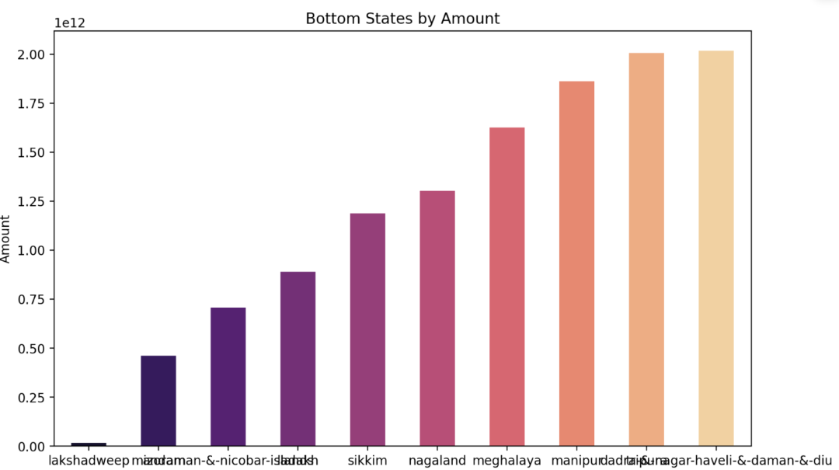
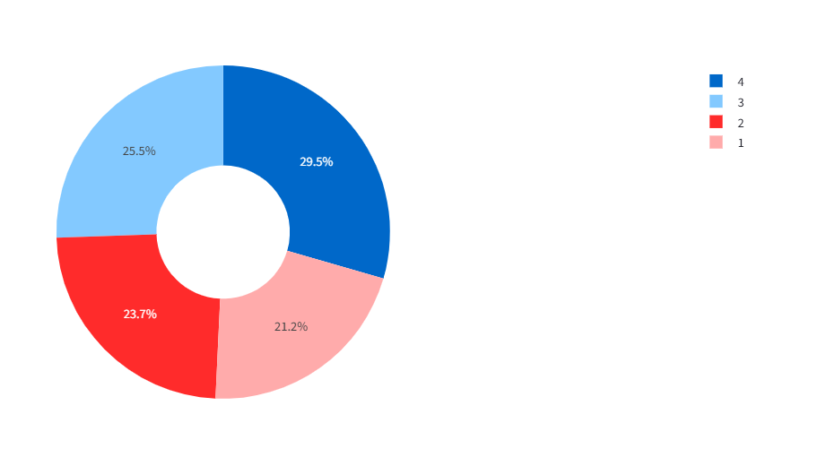
Decoding Transaction Dynamics

Slide 8
Insurance Penetration and Growth Potential
Insights
Top States: Maharashtra, Karnataka, Utter-Pradesh and Tamil Nadu lead in insurance transaction amounts.
Low States: Many Northeastern states and smaller states have very low insurance penetration.
Quarterly Trend: Q4 and Q3 usually have higher insurance transactions (possibly due to year-end financial planning).
Growth: Year-on-year growth shows a clear upward trend, meaning more people are adopting digital insurance over time.

Slide 9
Insurance Penetration and Growth Potential
Recommendations
Focus awareness campaigns in low-performing states to educate people on digital insurance benefits.
Offer discounts or cashbacks for first-time policy buyers in under-penetrated regions.
Target festive and year-end campaigns to capture the Q3–Q4 momentum.
Promote diverse insurance products (health, life, vehicle) to reduce dependency on one category.
Collaborate with local banks and agents to build trust in smaller cities

Slide 10
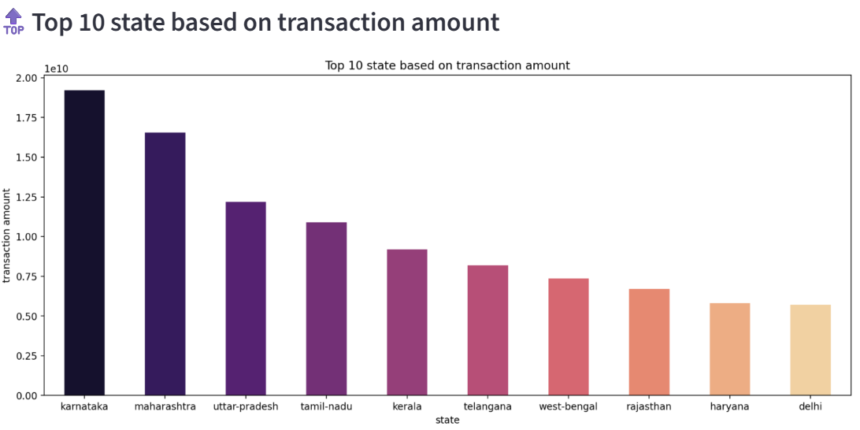
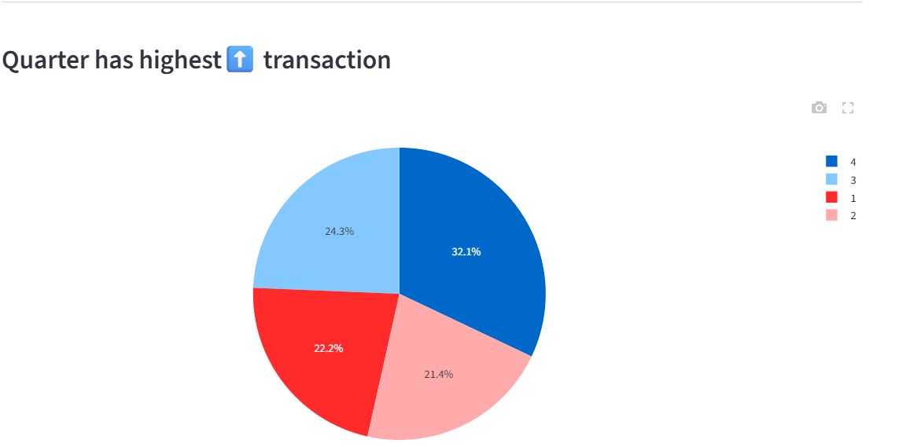
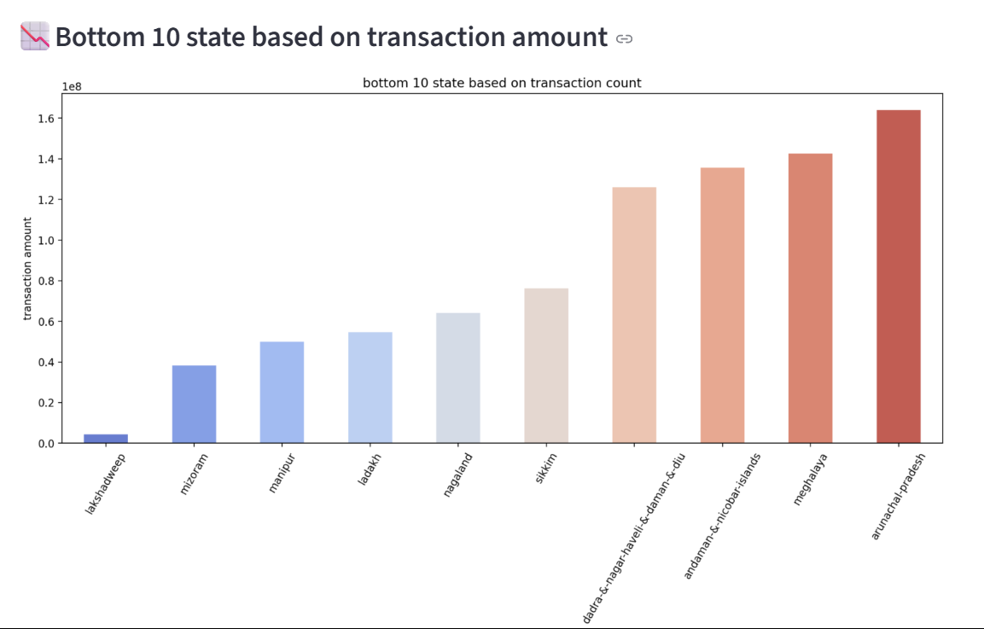
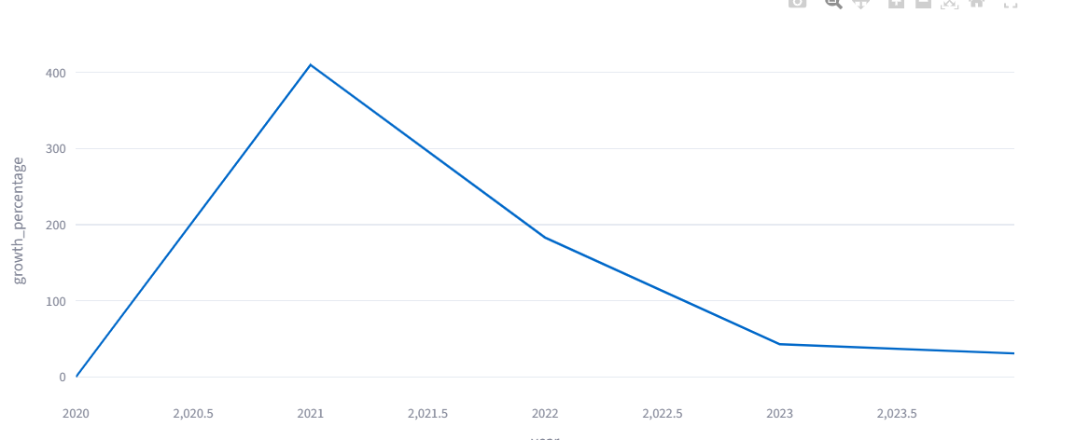
Insurance Penetration and Growth Potential

Slide 11
Transaction Analysis for Market Expansion
Insights
Top Districts: Big cities like Bengaluru, Hyderabad, and Mumbai lead in total transaction amounts.
Bottom Districts: Many rural districts and smaller towns have very low transaction values.
High-Growth States: Several states have grown more than 80% in transaction value since the previous year.
Low-Growth States: Some states have grown below 40%, showing limited adoption or saturation.

Slide 12
Transaction Analysis for Market Expansion
Recommendations
Focus marketing campaigns on low-growth states to increase adoption.
Invest in merchant onboarding in rural districts to raise transaction volume.
Strengthen infrastructure in high-growth areas to support future demand.
Launch special offers in low-performing districts to attract more users.
Collaborate with local businesses in slower-growth areas to promote digital transactions.

Slide 13
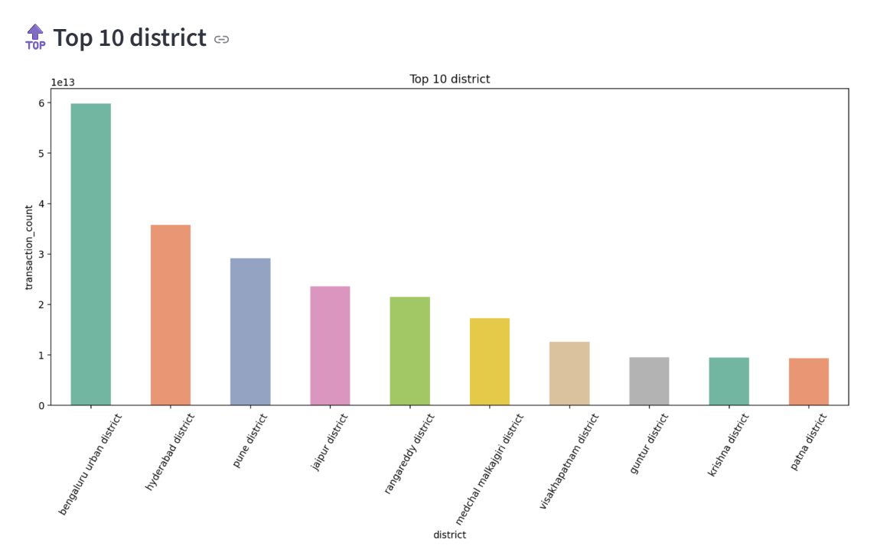
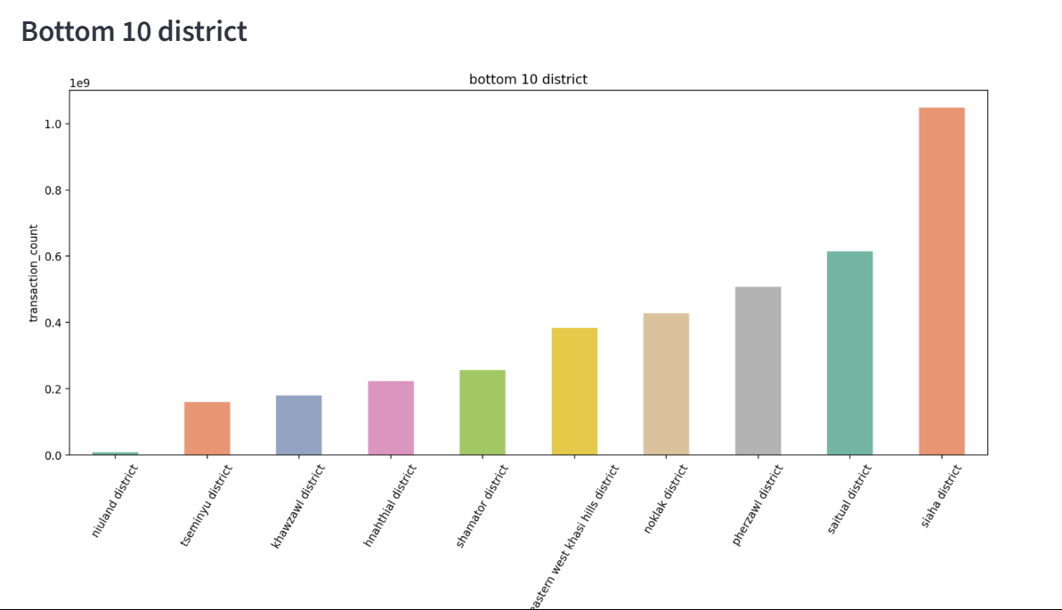
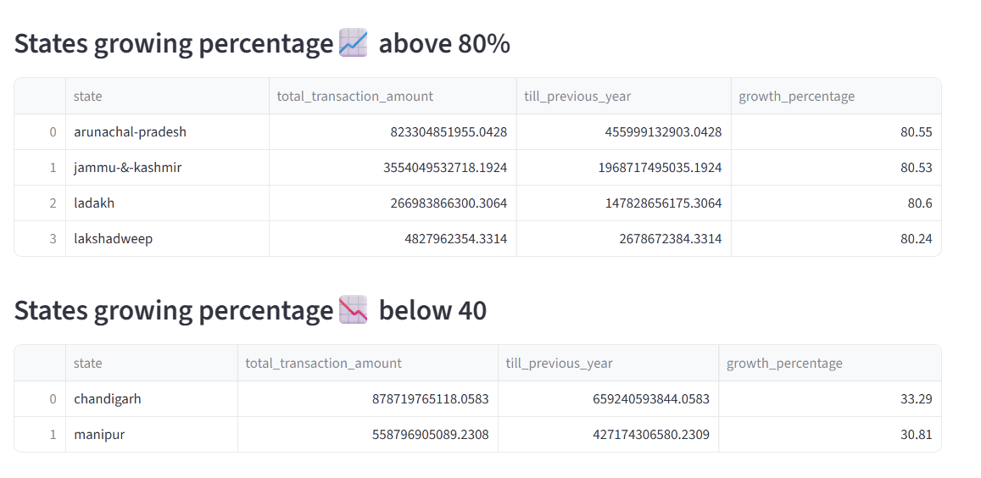
Transaction Analysis for Market Expansion

Slide 14
User Engagement and Growth Strategy
Insights
Most users are in big states like Maharashtra, Karnataka, and Tamil Nadu.
Smaller states (Mizoram, Manipur, Ladakh, Lakshadweep) have fewer users but are showing growth.
Urban areas have higher adoption than rural areas.
Usage spikes during festivals and special events.

Slide 15
User Engagement and Growth Strategy
Recommendations
Run awareness campaigns in smaller states.
Onboard more merchants in rural areas to make PhonePe accessible.
Launch festive offers to attract seasonal users.
Promote underused services like insurance and gold investment.

Slide 16
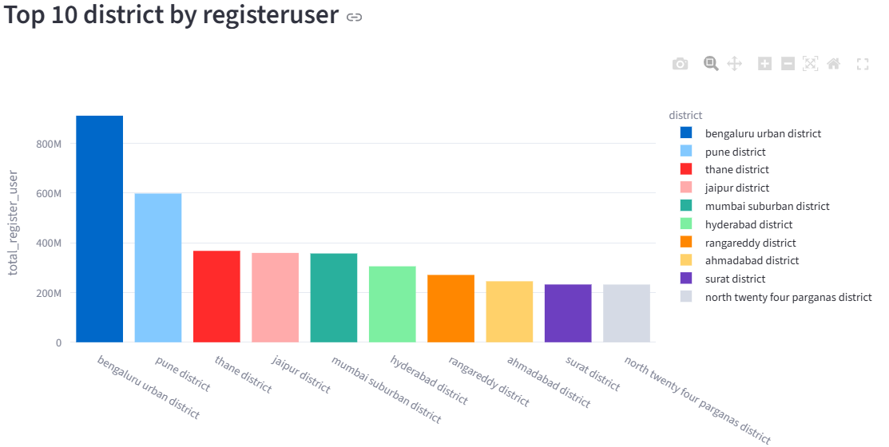
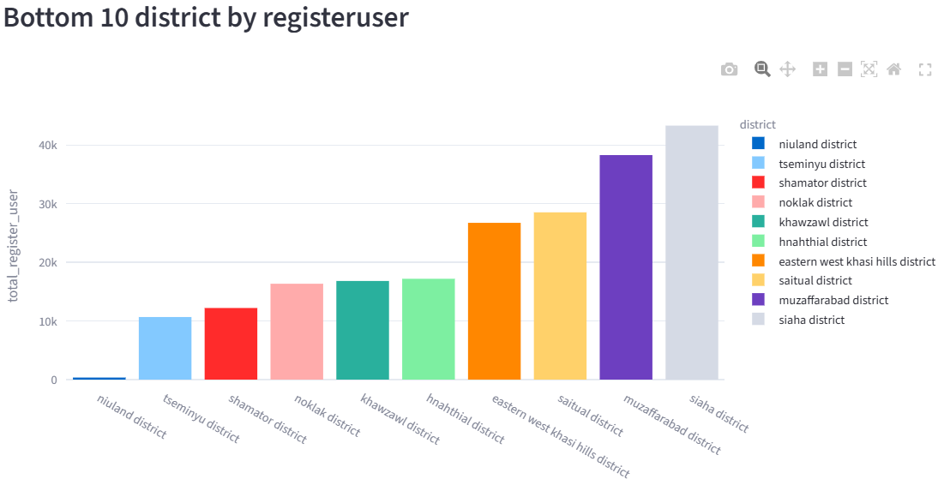
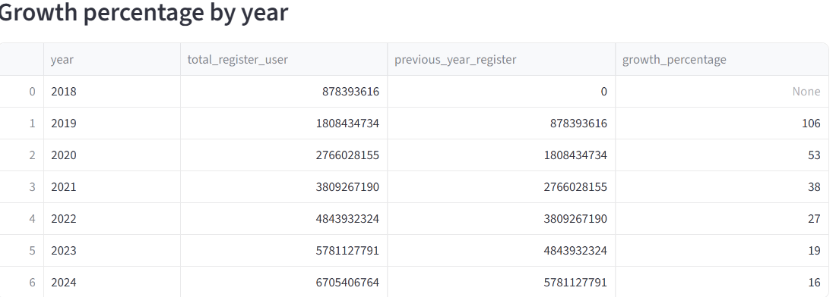
User Engagement and Growth Strategy

Slide 17
User Engagement and Growth Strategy
Insights
Top-performing districts and pin codes are concentrated in major urban centers.
Bottom 10 districts/pin codes show very low insurance adoption, indicating untapped markets.
Year-on-year insurance transaction amounts are steadily increasing.
Festival seasons (Q3) often see a slight boost in insurance purchases.

Slide 18
User Engagement and Growth Strategy
Recommendations
Launch awareness campaigns in low-performing districts and pincodes.
Collaborate with local merchants and agents for easier onboarding in rural and semi-urban areas.
Introduce seasonal/festival-based offers to boost adoption during peak spending periods.
Target urban high-performing regions with cross-selling opportunities for other financial products.

Slide 19
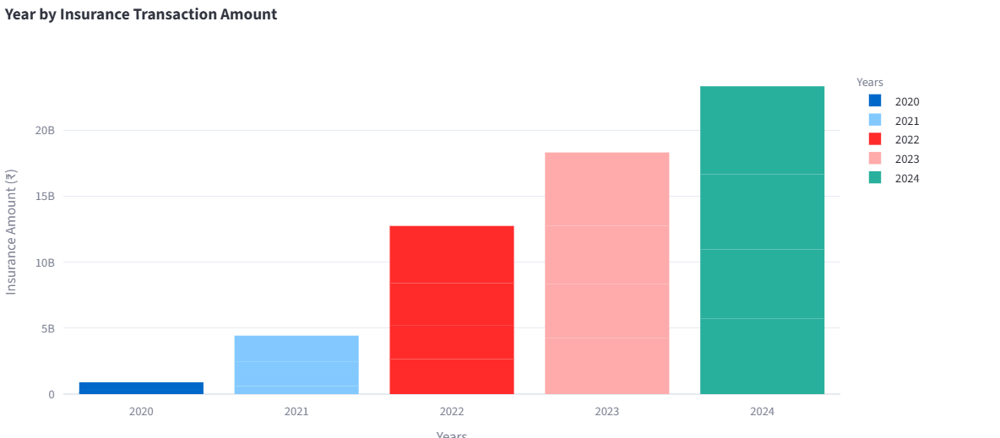
User Engagement and Growth Strategy

Slide 20
Overall Key Insights
Top contributors: Maharashtra, Karnataka, and Tamil Nadu lead in both transaction value and volume.
Emerging markets: Northeastern states and UTs like Lakshadweep, Mizoram, Manipur, and Ladakh are small in numbers but showing steady growth.
Category dominance: Recharge, Bill Payments, and P2P transfers account for the largest share of activity.
Seasonal patterns: Q3 sees the highest activity, driven by festivals and holiday shopping.
Adoption gap: Urban centers have strong penetration, while rural areas lag behind.

Slide 21
Overall Recommendations
Boost presence in underperforming states through awareness campaigns and local partnerships.
Onboard more merchants in rural districts to increase payment points and adoption.
Promote new services like insurance and investments to reduce category concentration.
Leverage festivals with special offers, cashback, and promotions.
Encourage P2P growth in smaller towns to drive user engagement and retention

Slide 22
Challenges & Learnings
Challenges
Learnings
SQL optimization-SQL optimization – using indexes, aggregations, and joins effectively.
Interactive visuals.-creating filters, maps, and charts with Plotly & Streamlit.
Business insight extraction-translating raw data into actionable recommendations.
Large dataset handling
Dashboard performance
Data preprocessing
State-wise map rendering

Slide 23
Conclusion From Data to Decisions
How the Analysis Helps Decision-Making
Market Trends Visibility – Spot top/bottom states & categories.
Customer Behavior Insights – Understand payment patterns.
Growth Opportunities – Identify untapped regions.
Potential Business Impact
Marketing – Focus on high-growth areas.
Resource Optimization – Better allocation to priority markets.
Improvements – Align with user needs.

Slide 24
Thank You contact email:sindhu7356@gmail.com

